Slide 1
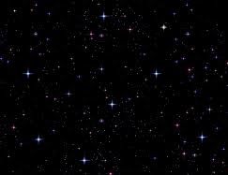
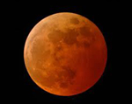
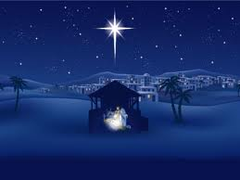
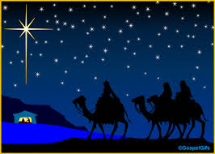
東方三博士
We Three Kings of Orient Are
S120

Slide 2
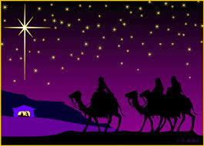
三位博士来自东方， 携带礼物献给君王， 经过田野、荒漠、山川， 日夜跟随星光。
We three kings of orient are, Bearing gifts we traverse afar Field and fountain, Moor and mountain, Following yonder star.

Slide 3
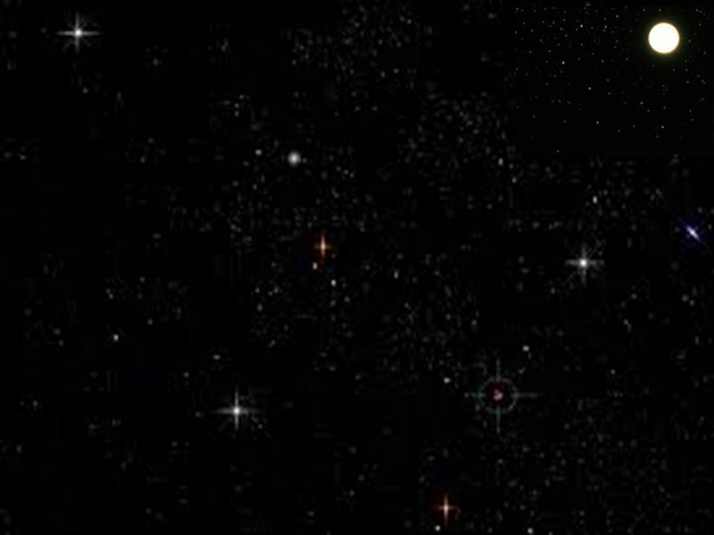
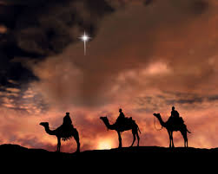
(副歌） 哦！奇妙明星放光芒， 灿烂无比真辉煌。
明星引领不断前进，直到朝见主真光。
O star of wonder, star of night, Star with royal beauty bright. Westward leading, still proceeding, Guide us to thy perfect light.

Slide 4
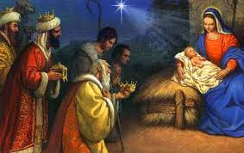
我献黄金尊贵至上， 做他冠冕贺他为王， 永永远远统治我们， 恩泽地久天长。
Born a King on Bethlehem's plain, Gold I bring to crown Him again King for ever, ceasing never Over us all to reign.

Slide 5
(副歌） 哦！奇妙明星放光芒， 灿烂无比真辉煌。
明星引领不断前进，直到朝见主真光。
O star of wonder, star of night, Star with royal beauty bright. Westward leading, still proceeding, Guide us to thy perfect light.

Slide 6
我献乳香芬芳四溢， 救主恩爱万民受益， 祈祷、感谢、赞美、颂扬， 当作馨香之祭。
Frankincense to offer have I, Incense owns a Deity nigh Prayer and praising, all men raising, Worship Him, God most high.

Slide 7
(副歌） 哦！奇妙明星放光芒， 灿烂无比真辉煌。
明星引领不断前进，直到朝见主真光。
O star of wonder, star of night, Star with royal beauty bright. Westward leading, still proceeding, Guide us to thy perfect light.

Slide 8
我献没药虽苦犹香， 预示坟墓痛苦凄凉， 忧伤、悲叹、流血、舍身， 主有得胜力量。
Myrrh is mine, Its bitter perfume breathes A life of gathering gloom. Sorrowing, sighing, bleeding, dying, Sealed in the stone cold tomb.

Slide 9
(副歌） 哦！奇妙明星放光芒， 灿烂无比真辉煌。
明星引领不断前进，直到朝见主真光。
O star of wonder, star of night, Star with royal beauty bright. Westward leading, still proceeding, Guide us to thy perfect light.

Slide 10
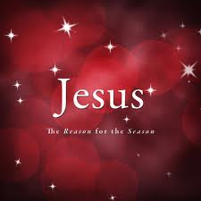
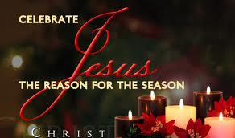
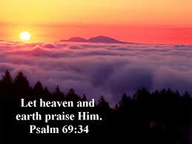
君王上主为人牺牲， 何等荣耀，他已得胜！
哈利路亚，哈利路亚！ 天上人间同唱。
Glorious now behold Him arise, King and God and Sacrifice! Al-le-lu-ia, al-le-lu-ia, Heaven to earth replies.

Slide 11
(副歌） 哦！奇妙明星放光芒， 灿烂无比真辉煌。
明星引领不断前进，直到朝见主真光。
O star of wonder, star of night, Star with royal beauty bright. Westward leading, still proceeding, Guide us to thy perfect light.

